Slide 1

A Global Analysis of Income Inequality (2010-2021)
UN SDG Goal: 10: Reduced Inequality
Cloud Data Analytics

Slide 2
EXECUTIVE SUMMARY
This report presents a comprehensive analysis of global income inequality trends from 2010 to 2021, building upon the objectives outlined below. The aim is to identify key socio-economic and geographic factors correlating with inequality levels and to model the relationship between development and inequality across different world regions. This analysis utilizes the provided Inequality in Income dataset and leverages data visualization techniques to present insights effectively as to meet the UN SDG Goal 10, reduced inequality.

Slide 3
PARTICIPANTS
Terungwa Emmanuel (Cloud Data Analytics); Responsible for data cleaning, SQL querying, and dashboard creation in Power BI.
Flavian Kazira (Cloud Data Analytics); Focused on data cleaning, report writing, and the generalization of insights from the analysis.
Babatunde Oyedele (Cloud Data Analytics); Handled visualizations, report writing, and the extraction of actionable insights.

Slide 4
SPECIFIC OBJECTIVES
To quantify and compare continental trends in income inequality by calculating key descriptive statistics (e.g., mean, median, range
To conduct a time-series analysis of income inequality to uncover significant trends, breakpoints, and patterns of change (upward, downward, or stable) across different continents over the 12-year period.
III. To investigate intra-continental disparities by analyzing the variation in inequality levels between countries
IV. To develop an interactive data visualization, dashboard that effectively communicates and enabling stakeholders to explore the data intuitively.
V. To synthesize data-driven insights into actionable recommendations for policymakers.

Slide 5

TOOLS USED
Advanced Excel; For data cleaning, checks, and quick profiling (missing values, outliers).
SQL; Store the cleaned dataset, run fast queries for summaries, unpivoting, joins, and time-based views.
Power BI; Build visuals and an interactive dashboard.

Slide 6
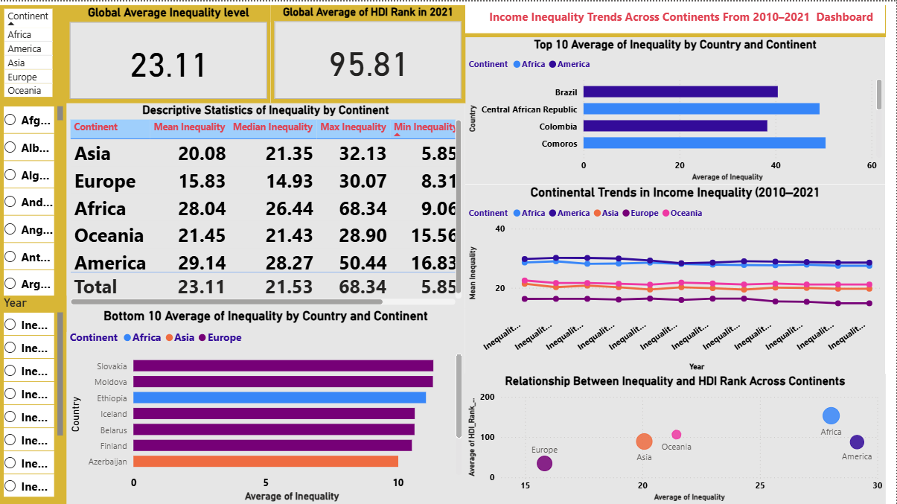
ANALYSIS AND RESULT
This study analyzes global income inequality across continents from 2010 to 2021 using descriptive statistics and time-series analysis. Results show that Africa and America with the highest average inequality, while Europe consistently records the lowest. Africa has both the highest mean and widest range, reflecting large disparities among its countries. America shows similarly high inequality but with less variation, Asia presents moderate levels, and Oceania maintains relatively low and stable inequality.
Time-series trends analysis reveal persistent high inequality in Africa and America, moderate stability in Asia, and consistently low levels in Europe and Oceania. Country-level analysis highlights extremes. Central African Republic, Haiti, and Brazil rank among the highest inequality countries, while European nations like Slovakia, Finland, and Iceland show the lowest.
Correlation with Human Development Index (HDI) indicates that higher development generally aligns with lower inequality, though variations exist. A Power BI dashboard integrates these insights, enabling interactive exploration of global inequality patterns.

